Slide 1


AI Assisted Sentiment Analysis Using Topic Modeling
Sushma Ghogale and

Slide 2


Introduction
Heavy surge in Customers providing feedback on Hotels online in recent times.
Hotel industry is heavily influenced by ratings and feedbacks provided by Customers.
Hotels are continuously looking for Customer feedback to improve features.
Tourists/Travellers count on reviews of the Hotel to judge the services.
Challenge is to map the keyword of the reviewer to the aspects of the hotel.
E.g. if review says “Easy access to nearest points” its pointing to location of the hotel.
Ratings are easier to handle, but they don’t help identify aspects, features and latent sentiments (positive, negative or neutral).

Slide 3
This experiment uses LDA Topic modelling algorithm to categorise feedback data into different subgroups, which is subjected to Sentiment analysis with Machine learning Classifiers to find the emotions.

Slide 4


Background
Humans can relate a comment provided to features of a Hotel easily.
E.g. “The Hotel has a large swimming pool and clean water!” and Humans can easily detect the emotions behind the reviews, But machines can’t
Lot of research has been done in this area to classify text in to features or topics and review them along with the sentiments associated with them
Blei et al developed topic modelling technique, LDA to train the Machine to behave intelligently and detects the topics across the document
Natural Language Processing (NLP) and Machine learning algorithms are helping analysts to classify sentiments
Technology is scaling up to handle large amount of text data being provided continuously by the Customers/Users

Slide 5

Benefits
Ability to classify the topic level sentiments of the reviewer
Ability for Companies to relate review comments to features of the hotel
Understand emotions for the features (Happy or not happy about the Hotel Facility, Service, Staff ,Location etc)
Consolidated view of the Customers experience, and preferences related to Hotel services
Opportunity for Hotels to improve their services to improve the ratings and hence the sale
Tool for travellers to assess the Hotels based on parameters of their choice and able select the Hotels suitable to their needs
Ability to handle large data set

Slide 6
Approach
Hotel Reviews Data Documents
Pre-processing and cleaning the dataset
Feature extraction (BOW)
Latent Dirichlet Allocation (LDA)
Topics of sentences
LDA Mallet to find Dominant topic
Sentiment Analysis classification on Topic
ML-Sentiment Classification ( pos , neg, neu)

Slide 7



Dataset
The Dataset used in this experiment is Hotel Reviews.
Gathered this dataset from Kaggle.com and dataworld.com websites.
Dataset has more than 500k reviews.
We are using only reviews and review ratings columns in this experiment
No user identifiable data was used to ensure compliance with regulations (e.g. GDPR)
Analysis followed ethics by avoiding any user related information like race, gender, geography etc..

Slide 8


Pre-processing:-
It is a technique to remove all unwanted texts from the document
Tokenising:- Process of dividing document in to separate words.
Stop-word removal:- Removing of words which has no meaning
Stemming and Lemmatisation:-Reduces the data size and transforms all tenses to present.
Bigram and Trigram:- consequently occurring pair of word and group of three words
Bag of words(Corpus):-
It is collection of pre-processed group of words and its value from the document

Slide 9
Latent Dirichlet Allocation (LDA)
LDA is one of the most used unsupervised text classification algorithm.
In this approach, to find aspects(topics) we are using LDA gensim along with Mallet’s implementation.
LDA is a concept of probability, documents are probability distribution of relating topics and topics are probability distribution of words.
Each topic has its own characteristics and is unique. Topics are the probability of words appearing in a set of document.
LDA can generate number of topics depending on the document. For this experiment we producing 12 topics and 12 words in each topic.
Each word in topic has its own weight, depending on the feedback of the reviewer. Words appear in high weighted to low weighted sequence (descending order).
The keywords for the topic labelling are chosen from the combination of highest weighted words.

Slide 10
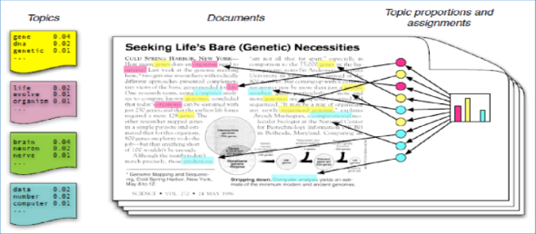
Latent Dirichlet Allocation (LDA) How LDA assigns words to topics

Slide 11
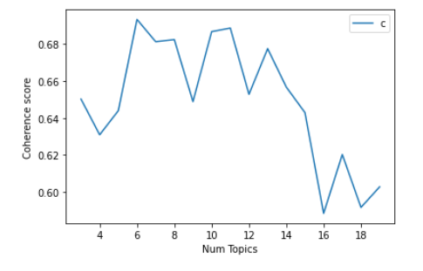
Coherence and perplexity
Optimal topics are the group of words which have high coherence value and less perplexity.
We choose optimal topics by finding the coherence value and model finds the number of topics with high coherence score.
We got perplexity score of -7.054584201409449
Figure shows number of topics which has high coherence values, for example topic 5 to 8 has coherence score more than 0.68 and topics 10 and 11 also has high coherence values. On the other hand topic 4 ,9 ,12 has least values

Slide 12
Sample Output
Staff were friendly and helpful
Free breakfast very limited. Just toast coffee cereal waffles, meat eggs hash. They said they only those weekends. Room very outdated.
Reviews from Documents
‘0.057*”staff” +
0.027*”friendly” +
0.027*”helpful”
0.102*"coffee" + 0.078*"breakfast" + 0.065*"poor" + 0.029*"cold" + ' '0.028*"fresh”
LDA generated Topics
Manually Labelled Topics
Staff
Food

Slide 13
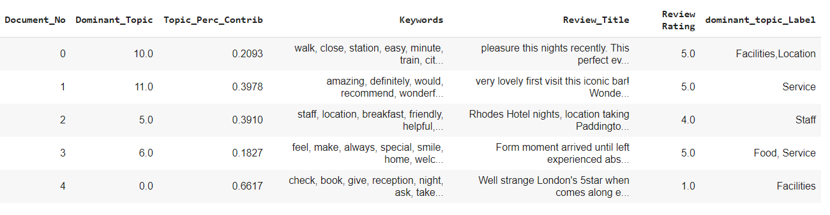
Dominant Topic
We use LDA mallet to choose dominant topics across the document. Manually labelled topics according to Keywords extracted from Reviews
Notes:
Reviewers spoke about these topics more compared to rest.

Slide 14
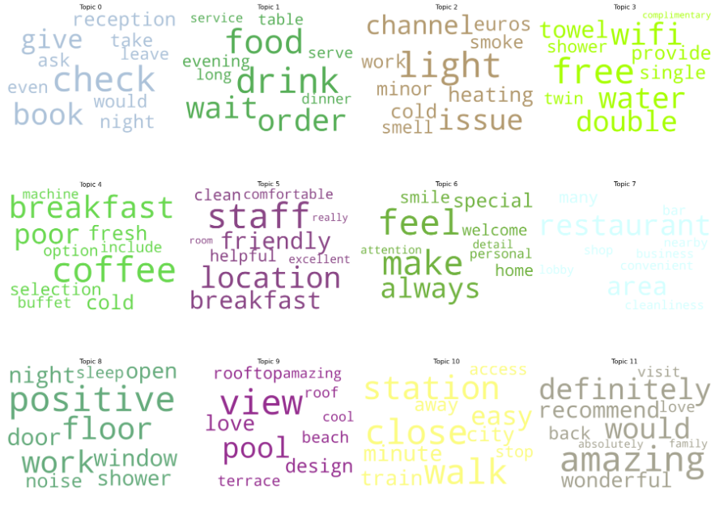
Word-cloud of topics

Slide 15
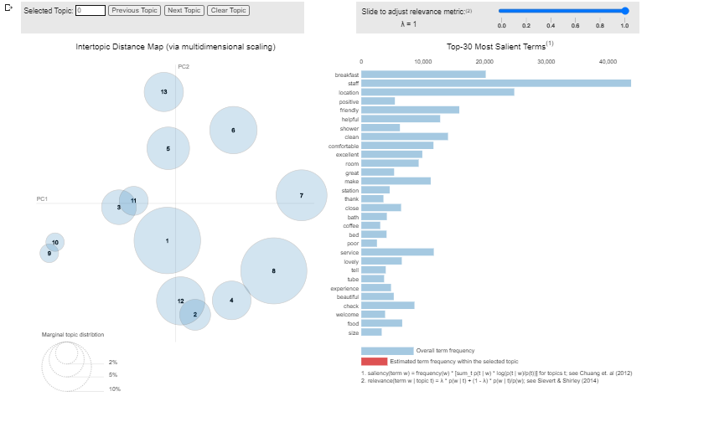
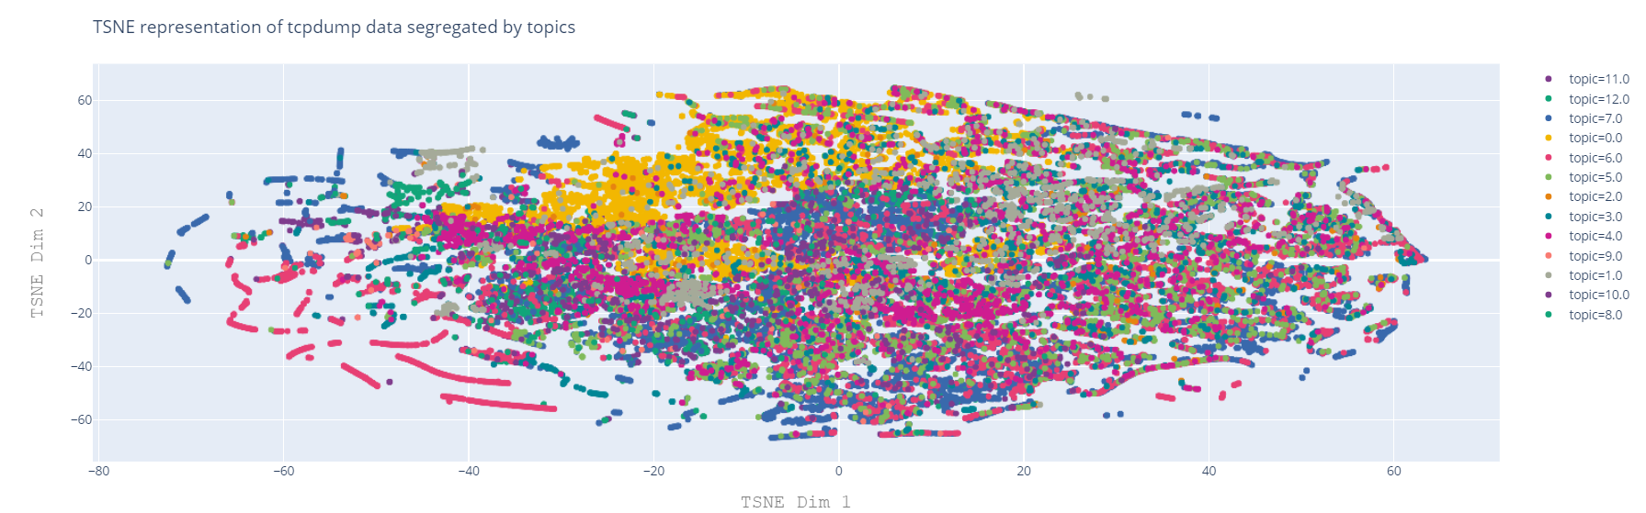
Visualisation of topics by pyLDAvis and TSNE graph
Notes:
Reviewers spoke about these topics more compared to rest.

Slide 16
Sentiment Analysis
Sentiment Analysis is a process of finding emotions out of review text provided by the Customer
To do this on aspect level, we use output of LDA dataset. i.e. Topic level Sentiment analysis is done using data generated from LDA.
In this experiment we have taken the review rating belongs to each review and categorised them in to Positive, Negative and Neutral with respect to reviewer ratings.
Review rating >=4 is Positive
Review rating <=2 is Negative
Review rating >2 and <4 is Neutral
Notes:
Reviewers spoke about these topics more compared to rest.

Slide 17
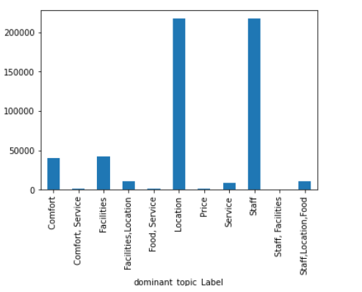
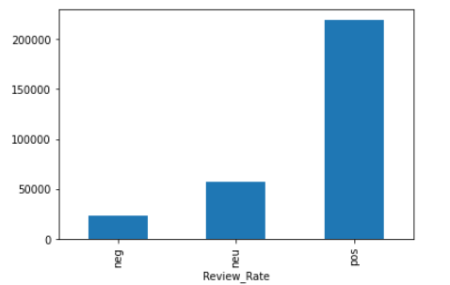
Dominant Topics and Classified Reviews Based on Reviewers Rating
Notes:
Reviewers spoke about these topics more compared to rest.

Slide 18
Machine learning Classifiers NB,SVM,LR and DT
To classify Sentiments on topic level we used Machine learning techniques.
Naïve Bayes classifier (NB)
Support Vector Machine (SVM)
Logistic Regression (LR)
Decision Tree classifier (DT)
We pre-process the dataset same way as LDA pre-processing technique and Machine learning classifier on topic level.
For Evaluation of topic level through four classifiers, we divided the dataset in to training and testing with 80% and 20% respectively for each topic.
We extract each topic and evaluate it by different classifiers, and check which classifier model gives high accuracy.

Slide 19




Evaluation
To find how accurate these classifiers perform on the model, We find Accuracy, F1-score, Precision and Recall.
True reviews
True Positive
(TP)
False Positive
(FP)
Predicted reviews
False Negative
(FN)
True Negative
(TN)

Slide 20
Evaluation
Evaluation is depending on how accurately the model has classified the text. for calculating, we need to classify True positive (Tp), True negative (Tn), False positive (Fp) and False negative (Fn) values.
Accuracy: The sum of correctly classified results for the data set
Precision: Precision is the ratio of correctly classified positive reviews against total classified positive reviews
Recall: Recall is the ratio of correctly classified positive reviews against the total actual positive reviews
F1-score is derived by combining precision and recall

Slide 21
Results
Comparison of Accuracy Result
 | Service | Staff | Location | Food | Comfort | Facilities | Price
Classifier
Logistic Regression | 0.844 | 0.76 | 0.744 | 0.90 | 0.493 | 0.631 | 0.62
Naïve Bayes | 0.844 | 0.76 | 0.742 | 0.90 | 0.525 | 0.636 | 0.63
Support Vector Classifier | 0.833 | 0.75 | 0.713 | 0.90 | 0.448 | 0.608 | 0.55
Decision Tree | 0.73 | 0.64 | 0.612 | 0.85 | 0.400 | 0.499 | 0.48
Comparison of Accuracy Results between various classifiers for sentiment Analysis on topic
Table shows Naïve Bayes and Logistic regression produce high accuracy. Overall, Naïve Bayes classifier produces high accuracy compared to other classifiers.

Slide 23
Detailed Result
Topic | Evaluation | Logistic Regression (LR) | NaiveBayes (NB) | Support Vector Machine (SVM) | Decision Tree (DT) | Dominant classifier
Staff | Accuracy Precision Recall F1_score | 0.76 0.99 0.76 0.86 | 0.76 0.99 0.76 0.86 | 0.75 0.98 0.75 0.85 | 0.64 0.67 0.64 0.66 | NB & LR
Location | Accuracy Precision Recall F1_score | 0.74 0.99 0.74 0.85 | 0.74 0.98 0.74 0.85 | 0.71 0.89 0.71 0.79 | 0.61 0.63 0.61 0.62 | NB & LR
Food | Accuracy Precision Recall F1_score | 0.90 1.00 0.90 0.95 | 0.90 1.00 0.90 0.95 | 0.89 1.00 0.90 0.95 | 0.85 0.87 0.85 0.86 | NB & LR
Service | Accuracy Precision Recall F1_score | 0.84 1.00 0.84 0.91 | 0.84 0.99 0.84 0.91 | 0.83 0.97 0.83 0.89 | 0.73 0.74 0.73 0.73 | NB & LR
Comfort | Accuracy Precision Recall F1_score | 0.49 0.79 0.49 0.59 | 0.52 0.97 0.52 0.68 | 0.44 0.54 0.44 0.48 | 0.40 0.41 0.40 0.40 | NB
Price | Accuracy Precision Recall F1_score | 0.62 0.95 0.62 0.75 | 0.64 1.00 0.64 0.77 | 0.55 0.68 0.55 0.60 | 0.48 0.50 0.48 0.49 | NB
Facilities | Accuracy Precision Recall F1_score | 0.63 0.94 0.63 0.50 | 0.64 0.99 0.64 0.77 | 0.60 0.85 0.60 0.70 | 0.50 0.51 0.50 0.49 | NB

Slide 24
Result
Overall, we see from the tables that Naïve Bayes classifier produces the high accuracy and F1-score among SVM, LR, and DT
This experiment has produced the results at 90% accuracy for topic “Food”, and the lowest accuracy produced by DT is 40% on topic “Comfort”.
SVM and LR have also performed well. Produced good accuracy on topics service, staff, location and Food.
SVM,LR and NB performs well in linear classification, but Decision tree is considered as non linear did not perform well in this model.

Slide 25
Limitations
Accuracy could have been more with larger data set
Manual labelling is time consuming
The Data analysed had more positive reviews (could bring bias)
Some reviews with generic text could not be classified in to subgroups
Accurate labelling is required for topic classification and opinion mining
Only dominant topics were classified in this experiment
Mixed topics (combination of more than one topics in a subgroup) were not classified in this experiment
LDA may take longer time to train depending on the size of the data
Extending this approach to other languages requires respective libraries

Slide 26
Conclusion and Future Work
Several researches are being done in this area due to demand
This area still in nascent stage owning to complexities in deciphering user generated content
This approach has worked successfully providing topics with high accuracy
Further work is suggested to increase the accuracy of all topics
Further work recommended on using Deep learning and neural network techniques on the text data
Recommnded to research on using different topic models like NMF, LSA etc…

Slide 27

Thank you….

